Slide 1
The Great Contraction : Who Caused It & How Did It Happen?
By : Charlie Haumesser
Discussants : Ashley Hucksoll & Mikael Leveille

Slide 2
Question
What were the underlying causes and who should beheld responsible for the collapse of the financial marketplace?

Slide 3
Thesis
Due to the actions and policies put in place by the United States government, the American citizen paid suffered substantial hardship and loss with collapse the financial market.

Slide 4
Key Topics
Collateralized Debt Obligations
Community Reinvestment Act
Sub Prime Leading
Fannie May & Freddie Mac

Slide 5
Collateralized Debt Obligations
Financial Firms Salomon Brothers and First Boston create the first collateralized debt obligation
CDOs are at the heart of the financial crisis
Investors could buy and sell assets worth 10 to 12x the underlying value

Slide 6
Collateralized Debt Obligations
CDOs are a financial tool that banks use to repackage individual loans into a product that can be sold to investors in the secondary marketplace.
Housing
Mortgage Backed Securities

Slide 7
Why do banks buy CDOs?
The cash they receive gave banks more cash to make more loans
It moved the default risk to investors and out of the banks hands
Gave banks a new product to sell
Increased share price and CEO bonuses

Slide 8
Benefits
Increased liquidity in the economy
Freed up bank debt, and allowed for investment opportunities and loan creation

Slide 9
Community Reinvestment Act
Enacted in 1977
Encouraged financial institutions to help meet the credit needs of the communities in which the operated in
Its purpose was to improve the deteriorating conditions of American cities
Particularly in low income areas
Revised in 1995 and 2005
President Obama is a strong supporter of the act

Slide 10
Subprime Lending
Loans where people may have a hard time paying back
Higher interest rates, poor quality collateral, and less favorable terms to make up for the increased risk
Supporters say it gives opportunity

Slide 11
Subprime Lending
Refers to the credit quality of the borrowers
Subprime credit ratings include:
Limited debt experience
Limited or no assets
Excessive debt
Past Bankruptcy filings

Slide 12
Subprime Lending
In order to make the terms look better for the borrower, banks offered an Adjustable Rate Mortgage
ARM
Low initial rate then it adjust month to month keeping with the Federal Reserve
One of the biggest lenders of subprime loans was Countrywide Financial

Slide 13
Countrywide Financial
Founded in 1969 in Calabasas, California
One of the largest subprime lenders
At one point financed almost 20% of all mortgages in the United States
Acquired by Bank of America in 2008

Slide 14
So What Happened?
Banks began to bundle, both prime and subprime mortgages together so the probable rate of return looked better
CRA changes allow lenders to receive a credit towards their affordable housing obligations for buying subprime securities

Slide 15
So What Happened?
Deregulation of the financial industry allow banks to grow and grow
Both commercial and investment banks
Commercial – make loans
Investment – raise capital and trade securities

Slide 16
Initiating A Crisis
In 2001 the “Dot-Com” bubble bursts
In an attempt to stimulate the economy, the Fed cuts interest rates on mortgages
Fed Chairman Alan Greenspan is accused of “creating an environment ripe for crisis” because of such low rates
In response, Fannie Mae and Freddie Mac begin to purchase large amount of subprime securities

Slide 17
Initiating A Crisis
Housing prices begin to increase as a response to the increase in real estate investment
The demand for homes go up, as it is viewed as an appreciating asset
Mostly from subprime borrowers

Slide 18
Initiating A Crisis
Financial institutions being to issue more and more mortgage-backed securities in search of greater profits
Investors assumed home prices would continue to rise

Slide 19
Crisis
Once the low introductory interest rates on subprime loans expired, people were unable to make payments at the new rate
Home prices begin to rapidly decline
Excessive foreclosures brought down property values of people who could repay their loans
Amount owed now greater than property value

Slide 20
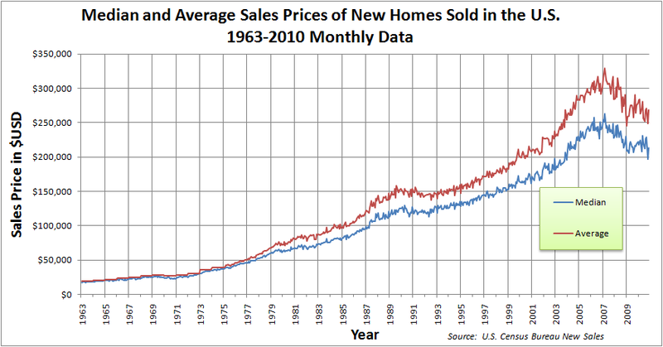

Slide 21
Crisis
Numerous subprime lenders declare bankruptcy
Investment bank Bear Stearns lose hedge funds with the increase in subprime mortgage defaults
Mortgage backed securities begin to fail
Global stock market suffer the largest fall since 9/11

Slide 22
Crisis
Bear Stearns is purchased by JPMorgan Chase for $2 a share
The prior year the stock was traded at $170
Fannie Mae and Freddie Mac are taken over by the government
Total collapse if they failed

Slide 23
Crisis
People lose their homes, retirements, and in some cases their jobs dues to the collapse of the financial marketplace

Slide 24
Government Bailouts
In an attempt to stabilize markets, the government began to bailout financial firms
AIG for example
Lehman Brothers filed for bankruptcy protection

Slide 25
Whose to Blame?
The actions of financial intuitions in their attempt to gain profits and expand margins, sent the global economy into a tail spin.
Commercial Banks, lending houses, investment banks and other financial institutions took advantage of Government deregulation and played a major role in the financial crisis

Slide 26
Sources
"Timeline of Events ." Economies of Crisis. N.p.. Web. 14 Apr 2013. <http://www.economicsofcrisis.com/timeline.html>.
"Community Reinvestment Act (CRA) ." Board of Governors of the Federal Reserve System. N.p., 26 march 2013. Web. 14 Apr 2013. <http://www.federalreserve.gov/communitydev/cra_about.htm>.
Armadeo, Kimberly. "CDOs (Collateralized Debt Obligations) ." about.com. N.p.. Web. 14 Apr 2013. <http://useconomy.about.com/od/glossary/g/CDOs.htm>.
"Mortgage-Backed Securities ." U.S. Securities and Commission Exchange . N.p.. Web. 14 Apr 2013. <http://www.sec.gov/answers/mortgagesecurities.htm>.

