Slide 1
Does the accumulation of external debt threaten the United States position in the global economy?
By Aziz Abubeker

Slide 2
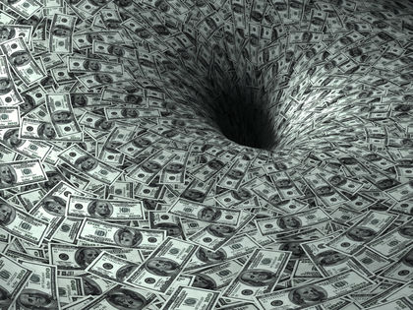
The United States increasing international debt does not threaten its position in the global economy.
State of the United States and its current position
Structure of US economy
International better Debt defined
Debt v.s. Equity and External Debt Sustainability
How the dollar solidifies U.S. position

Slide 3
United States Global Position
Largest Economy in the world
Invests and receives the most in foreign direct investment
Dollar most used international currency
Abundant natural resources
Leader in innovation and technology

Slide 4
Structure of the U.S. Economy
Market Oriented Economy
Strong Labor Force
Key Sectors: Manufacturing,
Financial, Healthcare, Government,
Technology

Slide 5
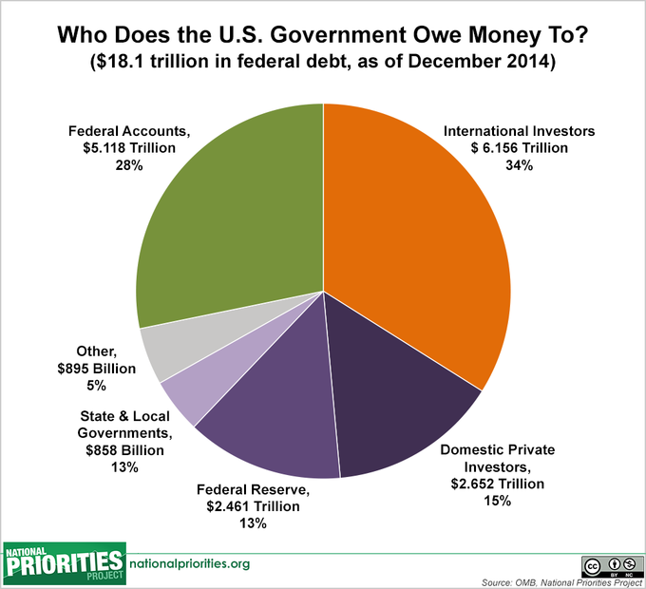
External Debt
Total amount a country owes to international creditors
Includes private and public debt
All debt is not bad
Of the US debt of 19 trillion only 34% is owed Internationally
All debt is not bad
Majority of debt is owed to Largest Trading partners

Slide 6
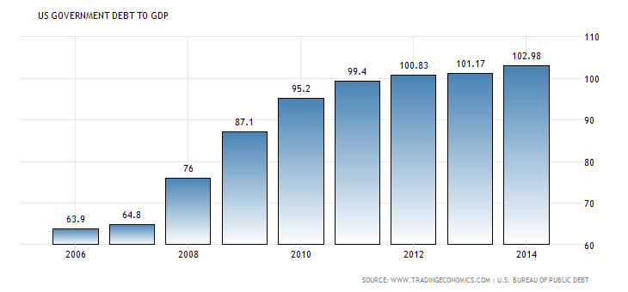
U.S. Debt v.s. Equity
How much debt can a country take on?
Assets of United States worth well more than combined national debt.
Is debt to GDP ratio a good measure of countries economic stability and credit worthiness?
"United States Government Debt to GDP | 1940-2016 | Data | Chart | Calendar." United States Government Debt to GDP | 1940-2016 | Data | Chart | Calendar. Accessed February 03, 2016. http://www.tradingeconomics.com/united-states/government-debt-to-gdp.

Slide 7
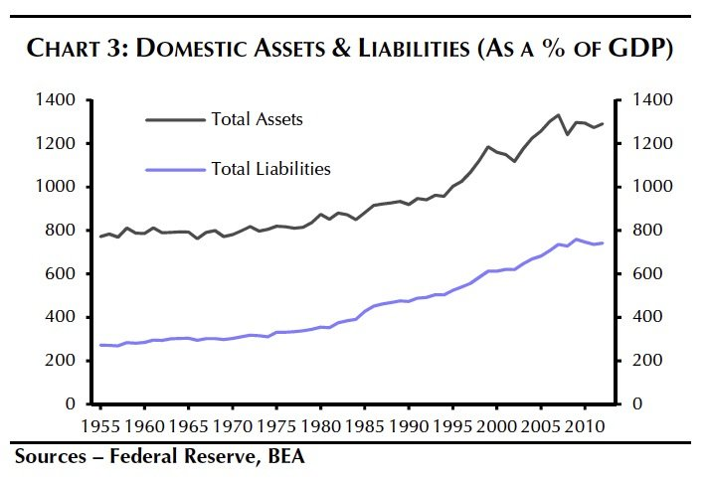
Assets compared to Liabilities
.
Federal Reserve Statistical Release. "FINANCIAL ACOUNTS OF THE UNITED STATES." FINANCIAL ACOUNTS OF THE UNITED STATES, December 10, 2015. Accessed February 3, 2016. http://www.federalreserve.gov/releases/z1/current/z1.pdf.

Slide 8
Power of the dollar
Currency is a form of non interest bearing debt that can only be issued by country.
The amount of money printed is entirely up to the country of issuance.
The US dollar is standard currency in global economy
World economies depend on the strength of the dollar and health of U.S. economy.
Printing enough money to pay the debt would cause inflation and devaluate the dollar.

Slide 9
Conclusion
United States position of power is not under threat from external debt.
1. Investment continues to increase, and despite the mounting external debt confidence remains among foreign investors
2. United States Total Assets worth considerably more than combined external liabilities
3. The global use of the dollar allows U.S. to exert control, and provides a certain degree of protection to the US
4. The overall health of the U.S. economy is intertwind, and very important to economies around the world.

Slide 10
Sources
Mokhtar, Khairiah Salwa. "Http://www.iosrjournals.org/iosr-jhss/papers/vol1-issue4/H0145964.pdf." IOSR Journal of Humanities and Social Science IOSRJHSS 1, no. 4 (2012): 59-64
Footnote: , last modified 2016, accessed February 4, 2016, . http://www.cfr.org/financial-crises/dangerous-us-government-debt/p22408. Last modified 2016. Accessed February 4, 2016. . http://www.cfr.org/financial-crises/dangerous-us-government-debt/p22408.
IMF. IMF. 2003. Accessed February 02, 2016. http://www.imf.org/external/pubs/ft/eds/Eng/Guide/file1.pdf
"United States Government Debt to GDP | 1940-2016 | Data | Chart | Calendar." United States Government Debt to GDP | 1940-2016 | Data | Chart | Calendar. Accessed February 03, 2016. http://www.tradingeconomics.com/united-states/government-debt-to-gdp.
Federal Reserve Statistical Release. "FINANCIAL ACOUNTS OF THE UNITED STATES." FINANCIAL ACOUNTS OF THE UNITED STATES, December 10, 2015. Accessed February 3, 2016. http://www.federalreserve.gov/releases/z1/current/z1.pdf.
"Ratio of Total Debt to Equity in the U.S. 2009-2015 | Statistic." Statista. Accessed February 03, 2016. http://www.statista.com/statistics/248260/total-debt-to-equity-ratio-in-the-united-states/.
"The Federal Government’s $128 Trillion Stockpile: The Answer to Our Debt Problems? | TIME.com." Business Money The Federal Governments 128 Trillion Stockpile The Answer to Our Debt Problems Comments. Accessed February 03, 2016. http://business.time.com/2013/02/05/the-federal-governments-128-trillion-stockpile-the-answer-to-our-debt-problems/.
"International Debt Statistics 2016." International Debt Statistics 2016. Accessed February 03, 2016. https://openknowledge.worldbank.org/handle/10986/23328.

