Slide 1
Personal Finance: Just how educated are we?
Thesis & Presentation by Steven Evans
Discussants: Gavin Oliphant & Charles Haumesser

Slide 2
Objective
To justify how consumers are ripped off through every day financial matters.
Notes:
Opening:
- The reason that I picked this topic is because I have found a career path in financial services. Now, I am not trying to brag, but in financial services, we deal with things such as Debt, Investing and Insurance. So, the reason why I decided to do my thesis on this topic is because not everyone is educated with financial concepts, but the main reason is because by doing this research, I am actually doing myself a favor by looking into this more for my job. I can actually say that once this paper s finally written, I will have learned something that I will actually grasp and apply to real-life.
The reason I say this is because how many things do we learn in college that we actually use? → NEEDS MORE WORK
When I say “finance” I don’t want you to think of – CAPM, Derivative Markets, Fiscal Policy or even Portfolio Theory – although Portfolio Theory is an important topic – however, I want you all, for a moment to toss out these complex and theoretical topics and focus on your every day life. Just how much do you know about personal finance?

Slide 3
Problem: Why?
Everyday Financial Products that most people are not educated in:
Debt (Credit Cards, Mortgage, Student Loans)
Investing (Retirement, Stock Market, Mutual Funds)
Life Insurance
Savings
Budgeting
Notes:
A couple questions I want to consider in my thesis:
Why isn't Money 101 taught to finance majors?
Why aren’t college students taught about the different types of loans they are able to receive – such as private and government subsidized and unsubsidized – and why are they offered thousands of dollars in loans at the age of 18?
Why do we give banks OUR money to hold so they can do what they want with it?
Why are the unemployed, disabled and young college students offered credit cards?

Slide 4
Money 101
Spending
Habits are mainly learned by parents/guardians
Pay for value, not price
Reckless Spending
Budgeting
Banking & Investing
$10.6 Trillion: U.S. bank deposits at end of 2012, a record high¹
Notes:
Although all of the information is out there on the web, you can find it in books, if there was any sort of elective that college students should take, it would be called Money 101.
However, First and foremost, habits are a big factor as to just how consumers aren’t aware of their financial habits.
Whether its reckless spending, failing to repay obligations, saving, frugality, being cheap or mattress stuffing, depending on our parents’ spending habits are learnt by our parents/guardian
The old saying “you get what you pay for” is correct, in a sense. Value is based on opinion in a sense, however, there’s a difference between a plastic knife and a steak knife. What I mean by that, is that you can pay less for a plastic knife and it will either break or not be able to cut through a steak properly (sorry if there are any vegetarians or vegans out there), Compared with a real steak knife, yeah, you might have to pay more for it, but it will probably be able to cut through 1,000 + steaks. That’s value.
Most of the time people pay for the name brand – again, that choice is up to you, however, cheap is not always the best way to spend money.
Budgeting:
How many of you budget your money?
Okay, so you have your cash flow and expenses all figured out? (Say “yay” to those who do and shame on those who don’t)
-- If not many do -→ And this is exactly why I am conducting my thesis on this topic. If we don’t plan and figure out our finances, how are we ever going to get ahead? I’m sure most people hear the word “budget” and think “yeah….i’ll get to it” – or – they just cringe.
And you call yourself an Economics and finance major….(attempt at a joke)
By failing to plan, you are planning to fail, especially when
Banking:
- Does anybody know they current interest rate on a CD, Savings account or Money Market Account?
- Well, there is a lot of money circulating in deposits.
- The interesting thing about deposits are that they don’t really provide a large return.

Slide 5
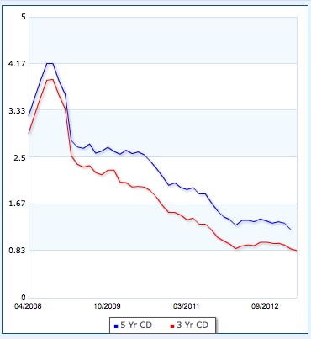
Avg. CD rates
Five Year vs. Three Year CD Rates
Source: http://www.bankrate.com/funnel/graph/default.aspx?cat=7&ids=138,124&state=zz&d=1825&t=MSLine&eco=-1
Notes:
This graph shows an average CD return of under 1%.
What I want to find out is why people choose CD rates over investments, such as Mutual Funds.

Slide 6
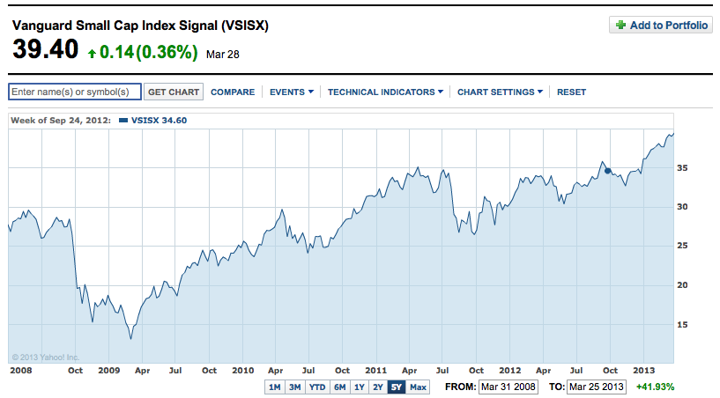
Mutual funds
Source: http://finance.yahoo.com/echartss=VSISX#symbol=vsisx;range=5y;compare=;indicator=volume;charttype=area;crosshair=on;ohlcvalues=0;logscale=off;source=undefined;
Notes:
Here is a chart of a Mutual Fund, Vanguard Small Cap Index Signal.
This is the five-year performance of the fund, and yet it has been riding a Bull Market ever since the crisis in 2009.

Slide 7
Mutual funds
The VSISX – Vanguard Small Cap Index Signal is an example of a fund that has weighed with a 0.1000 expense ratio and has delivered a 13.738 percentage return.²
Notes:
This is just a brief example of a Mutual Fund that has delivered extensively vs. the Average CD rate in the previous slide.

Slide 8
DEBT

Slide 9
Credit cards
Financing
0% APR Offers
Minimum Monthly Payments
Defaulting
Hurts Fico Score
Could result in a
Improper Usage
Charging day to day expenses and bills
Notes:
The goal of a 0% APR offer, especially at a department store, is to have the balance paid within the time period that the offer is valid.
Making the Minimum Monthly Payment during a 0% APR financing offer is okay, because there will be no interest charged on the CC until the period is over. However, consumers should be aware that if their balance has not been paid off at the end of the trial period, then all of the interest that could have been accumulated during that period will be added onto the current CC balance.
Defaulting on a CC can make life miserable and can result in the decrease of a credit score, inability to obtain more credit at a reasonable interest rate or even result in a legal judgment.
What I mean by improper usage is to live off of your credit card. To charge bills and everyday expenses on it.

Slide 10
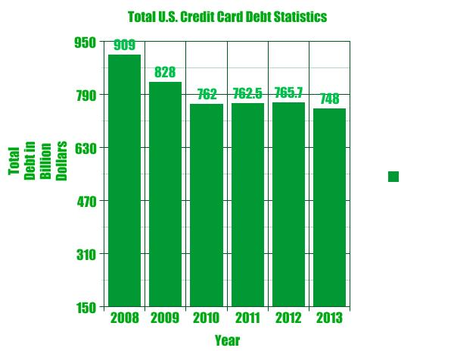
Total credit card debt
Source: http://nomorecreditcards.com/about-us/credit-card-debt-statistics/

Slide 11
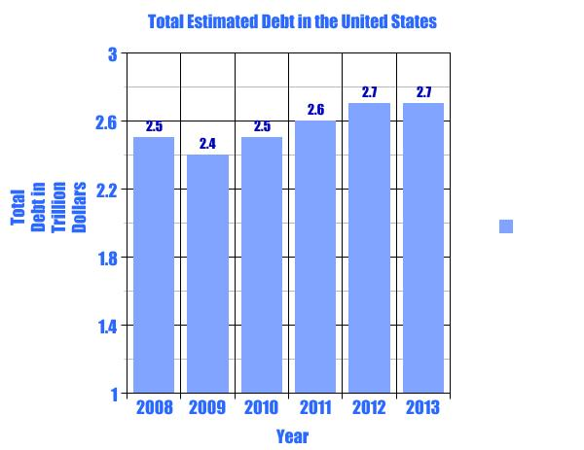
Total debt
Source: Source: http://nomorecreditcards.com/about-us/credit-card-debt-statistics/

Slide 12
Conclusion
What do I hope to achieve through my conclusion?
To understand why the average consumer gets taken advantage of with financial products
To describe why being financially literate can benefit consumers in the long-run
Notes:
In this thesis, I plan on discussing the poor money habits American consumers have.

