Slide 1
Poverty Reduction: World Bank and the IMF
Alieu Baldeh
Senior Seminar
Buffalo State
10/27/2014

Slide 2
Definitions
Poverty: the state of one who lacks a certain amount of material possessions or money.
Extreme Poverty: a condition characterized by severe deprivation of basic human needs, including food, safe drinking water, sanitation facilities, health, shelter, education and information.

Slide 3
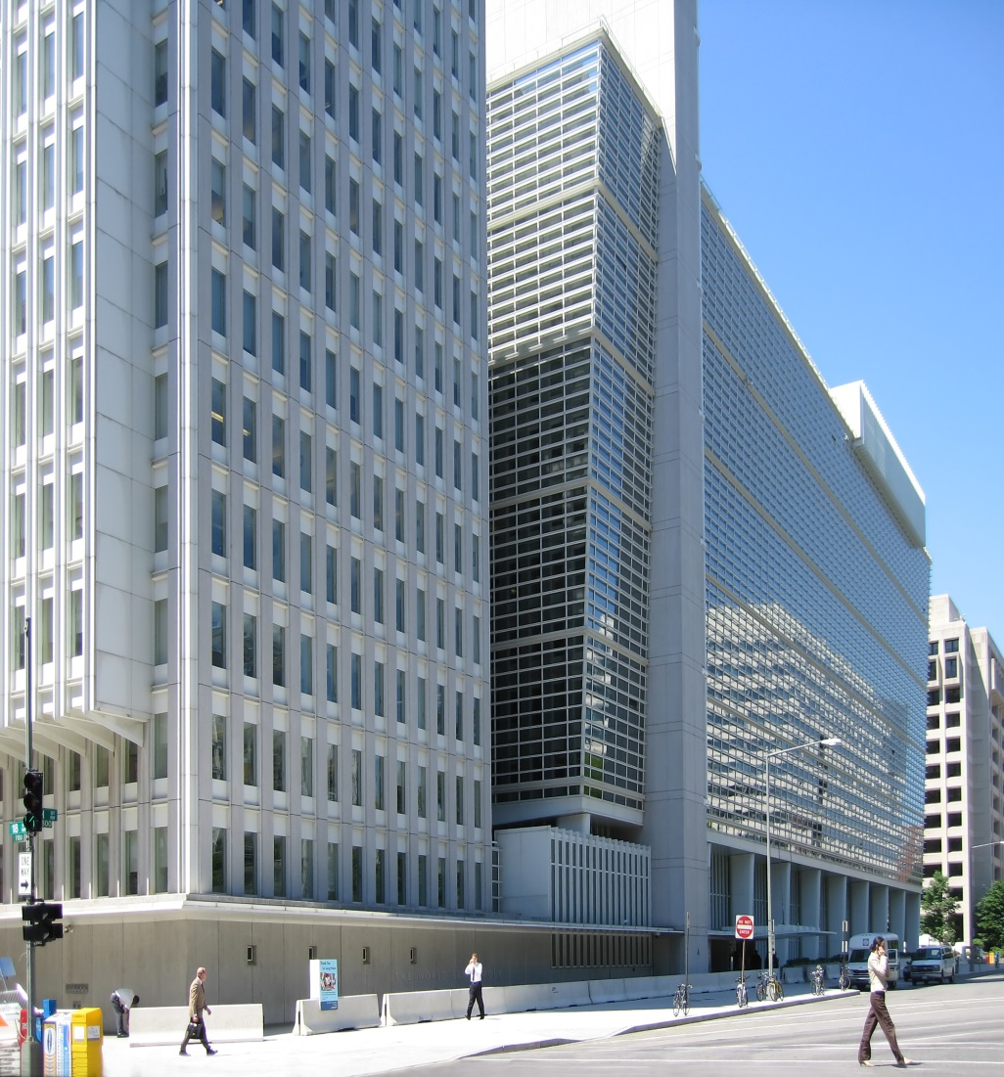
World Bank
Motto: Working for a World Free of Poverty.
Offer support to developing countries through policy advice, research and analysis, and technical assistance.
Provide low-interest loans, interest-free credits, and grants to developing countries.
Vital source of financial and technical assistance to developing countries around the world.

Slide 4
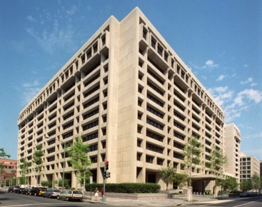
International Monetary Fund
The IMF promotes international monetary cooperation and exchange rate stability, facilitates the balanced growth of international trade.
Provides resources to help members in balance of payments difficulties or to assist with poverty reduction.

Slide 5
Theories
Neoclassical theories argue that governments should not intervene in the economy; in other words, these theories are claiming that an unobstructed free market is the best means of inducing rapid and successful development.
Dependency theory is the notion that resources flow from a "periphery" of poor and underdeveloped states to a "core" of wealthy states, enriching the latter at the expense of the former.
According to the linear stages of growth model, a correctly designed massive injection of capital coupled with intervention by the public sector would ultimately lead to industrialization and economic development of a developing nation.

Slide 6
Facts
Almost half the world — over three billion people — live on less than $2.50 a day.
According to UNICEF, 22,000 children die each day due to poverty.
World gross domestic product (world population approximately 6.5 billion) in 2006 was $48.2 trillion in 2006.
The GDP (Gross Domestic Product) of the 41 Heavily Indebted Poor Countries (567 million people) is less than the wealth of the world’s 7 richest people combined.

Slide 7
Facts continue
The world’s wealthiest countries (approximately 1 billion people) accounted for $36.6 trillion dollars (76%).
The world’s billionaires — just 497 people (approximately 0.000008% of the world’s population) — were worth $3.5 trillion (over 7% of world GDP).
There are 2.2 billion children in the world, and 1 billion are in poverty.

Slide 8
Questions
Thesis: The World Bank and IMF have been in existence for 70 years (est. 1944), yet there’s extreme poverty in many parts of the world, how effective are their policies in poverty reduction?
What the most affected regions and what percentage of the funds do they receive to promote development?
What policies have been identified as failed policies? Why did they fail?

Slide 9
Questions continue
Should the World Bank be for short term lending as opposed to long term, will this adequately help reduce extreme poverty?
Explore the past and current strategies, how have they changed?
What policies might work in the future?

